Slide 1
Private healthcare and competition rules - what you need to know
Louise Banér, Director, CMA

Slide 2
Agenda
CMA’s role
Why competition law matters
What you can and can’t do
Promoting best practice/compliance
Questions

Slide 3
CMA’s Role
UK’s primary competition and consumer law enforcement agency responsible for promoting business competition in the UK
CMA private healthcare investigations:
2014 Private Healthcare market investigation
2015 Private insured
ophthalmology services
2020 Private self-pay
ophthalmology services

Slide 4
Why competition law matters
Effective competition delivers better outcomes for consumers. It ensures that price and output in any market are optimised.
Competition Law exists to ensure that the benefits of fair and open competition are realised
When businesses agree to avoid competing with each other, they undermine this, with harmful consequences for consumers.

Slide 5
Why competition law matters
Competition rules apply to private healthcare in same way as for other businesses, including independent healthcare professionals
Consequences are serious:
Fines of up to 10% of turnover
Directors banned for up to 15 years
Prison for individuals in most serious cases
Damages claims from customers

Slide 6
What you can’t do
It is illegal to:
fix prices or share commercially sensitive information such as future pricing information
facilitate price fixing or sharing of commercially sensitive information
share markets (e.g. places or customers)
discuss your future commercial plans such as responses to tenders or pricing initiatives,
with competitors e.g. medical practitioners

Slide 7
Group Working
If you and professional colleagues act as ‘single undertaking’ then an agreement on the fees you charge as a group is not considered an agreement between competitors.
Groups and their members may wish to take specialist legal advice on whether the group constitutes one undertaking for competition law purposes.

Slide 8
Group AND individual working
If you also work outside the group as a sole trader, then (for these purposes) you DO NOT form a single undertaking with the group.
This means that you may be directly competing with the group and any other members of the group who also act as sole traders.
Consider establishing clear rules and procedures and seeking expert advice

Slide 9
What you can do
You can collaborate in a group as a single undertaking if conditions met
You can find out prices charged by others if this is publicly available information and you can independently decide to charge the same
You can cooperate and exchange information to achieve positive outcomes including joint purchasing of services, educational activities or exchanging information such as offering new and additional services and extending opening hours

Slide 10
Avoiding Facilitation
Reasonable for individuals working within the same industry to co-operate in certain circumstances (previous slide)
May be tempting for providers or co-ordinating bodies to facilitate this co-operation
Must ensure that this stays within the law
If in doubt – do not participate – state that you will not do so and the reasons why

Slide 11
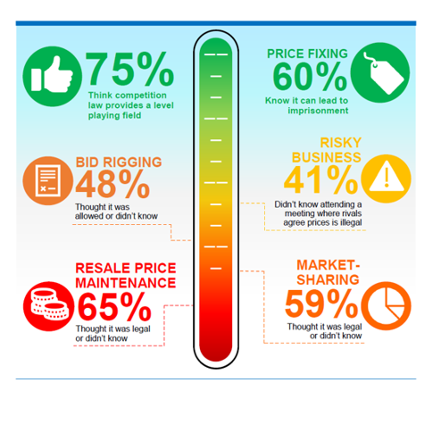
Research - business understanding of the law
Research shows businesses lack understanding of competition law
In times of economic stress anti-competitive activity can be more prevalent
The consequences of getting caught breaking the law are serious – businesses ought to take competition law seriously

Slide 12
Best practice / compliance
Ensure you and anyone who works for you in private practice receive appropriate competition compliance training /awareness
Promote compliance in your consultant groups
Be aware of facilitation
Seek legal advice if think you are at risk of breaking competition law
Report anti-competitive behaviour to CMA

Slide 13
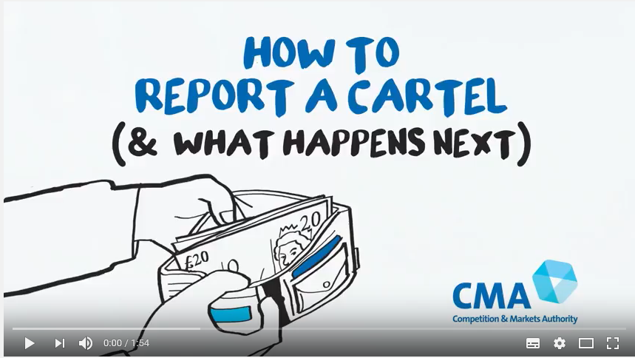
How to report to us
If you have information about a cartel (e.g. price-fixing, market-sharing, bid-rigging) but are not directly involved
If you think you may have been involved in something illegal, you may escape fines or sanctions if you come to us first
Report via our online reporting form or email: cartelshotline@cma.gov.uk

Slide 14
Where to find out more
Case study: private healthcare provider fixed prices with consultants
Private medical professionals: information on competition law
Private medical professionals: information about fees
For general information on how best to spot and report anti-competitive practices visit our cheating or competing page

Slide 15
Questions?

