Slide 1
Appraiser training for Medical Appraisal 2020 - a rebalanced appraisal in the context of the COVID-19 pandemic
Appraisal – “the 2020 vision”
Notes:
Welcome to this presentation on appraiser training for Medical Appraisal 2020
Appraisal was suspended in March 2020 for most doctors to allow them to focus on the clinical demands of the COVID-19 pandemic.
This suspension created an opportunity, to ensure that, when re-started, the appraisal process meets the needs of doctors and patients at this time, within the existing GMC requirements. Medical Appraisal 2020 puts forward a revised appraisal process in the context of the pandemic that recognises the disruption COVID-19 has caused. Hard-pressed doctors should all feel supported by their appraisal, without being distracted from their clinical care by excessive or disproportionate documentation.
Appraisal is now restarting with a rebalanced focus and emphasis which builds on what the best appraisals already provided.
This presentation has been made for appraisers returning to their role. It will explain the details of the rebalanced appraisal process and the key messages for appraisers to bear in mind.

Slide 2
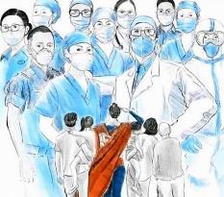
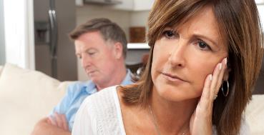
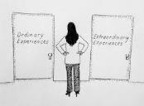
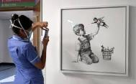
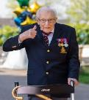
COVID-19 has affected every single doctor
Notes:
Covid-19 has affected every single doctor-professionally and personally
Professionally - doctors working on the clinical “frontline” for example-in acute medicine, A+E, ITU and General Practice will have had direct experience of dealing with a new critical illness for which there is no definitive treatment– managing patients dying in hospital and care homes without any family present –and sometimes having to care for sick and dying colleagues.
Some doctors returning from retirement or non-clinical roles have really enjoyed coming back to patient-facing work and have welcomed the chance to contribute.
For other doctors, the pandemic period has been one of frustration and guilt if their routine work was all cancelled or if they have been at home shielding themselves or others.
Most of us have probably had a mixed professional experience and we have all had to learn a lot about this virus and how to respond to a pandemic.
Personally - doctors have had to deal with the impact of COVID-19 at a personal level, coping with significant individual risk, especially if adequate PPE was not available. Fears for their own health has been added to fear for their family and friends.
Doctors may have had financial problems, relationship difficulties, personal loss or other family worries, or mental health issues.
Some doctors have had childcare issues, with grandparents and child minders not available, and the challenges of combining working remotely with home schooling.
In June 2020, a BMA survey found that almost half of all doctors have reported negative impacts on their stress levels and mental health due to COVID-19.
Appraisers will have a very important role to play in helping doctors to reflect on the impact of the pandemic. For some doctors, their appraisal will be their first chance to debrief, or simply discuss their experiences with a peer.

Slide 3
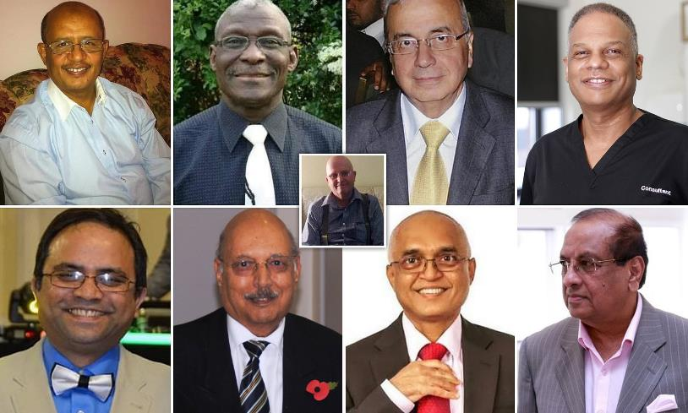
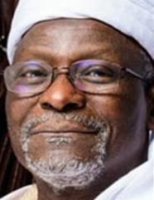
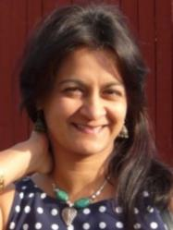
But some have been disproportionally affected
Notes:
Covid 19 has had an impact on all doctors, but some have been disproportionately affected
As we saw the first photographs of UK doctors who had died from COVID-19 –it was immediately obvious that most of them came from Black, Asian and Ethnic Minority backgrounds.
An analysis in the Health Services Journal in April 2020 reported that 44% of doctors in England are from Black, Asian and Ethnic Minority backgrounds but at that point they represented 95% of deaths amongst UK medics.
The reasons for this are not yet fully understood - although several studies are ongoing -, but are likely to include a higher prevalence of co-morbidities with conditions known to worsen the outcome in COVID-19 patients such as hypertension, diabetes or vascular disease, plus some suggestion that staff from ethnic minority backgrounds may be less likely to seek care when needed or to speak up about inadequate PPE.
This has created additional stress for these doctors both in terms of their own health and safety and their fear for their families and communities.
Other doctors are at increased risk because of pre-existing health concerns, increasing age or pregnancy. They have also been disproportionately impacted by the pandemic.
Specific support for all these doctors focuses on encouraging regular health checks to diagnose and manage conditions known to worsen their prognosis if infected, and to make the work environment as low risk as possible in terms of COVID-19.
There are several tools that can be used to identify those workers most at risk from COVID-19, and links to these risk assessments and other sites offering specific advice are in the doctor support resource document which forms part of these training materials. All appraisers should have access to this list, together with any additional local resources available to their appraisees.

Slide 4
Re-introduction of medical appraisal in the context of the COVID-19 pandemic
Notes:
Re-introduction of medical appraisal
On 17th March 2020, in response to the emerging pandemic crisis, the GMC moved forward by twelve months all revalidation recommendation dates up to 30th September. In June 2020, this provision to move revalidation recommendation dates forward twelve months was extended for all dates up to 16th March 2021. This move provides doctors with extra time to collect all their supporting information, if necessary, although those that are ready can still be recommended for revalidation by their RO.
Shortly after the first GMC announcement, appraisal was suspended "until further notice" across all four nations of the UK, in order to free up clinical time for doctors and appraisers.
Some doctors expressed disappointment at being left without the crucial support and thinking time of their annual appraisal.
Other doctors were relieved by the suspension of a process that they saw as an administrative burden.
The unexpected pause has created an opportunity to review what doctors need at this time and to streamline and modernise the appraisal process in line with the flexibility already present in existing GMC guidance and from examples of best practice from the most highly-valued appraisals.
The decision to restart appraisals from October 2020 has been taken in order to provide appropriate support to doctors in the context of the pandemic
But there is clear agreement that now, more than ever before, medical appraisals must not take doctors away from patient care because of an excessive burden of preparation.
Appraisals must also have a real focus on the impact that the pandemic has had on the doctor’s personal and professional development and their health and well-being. There must also be some recognition that the way doctors work has changed, probably forever. The guiding principles of the appraisal process have not changed, but there has been a shift in scope, focus and emphasis.
These changes are reflected in the important, simple messages contained in the next 12 slides

Slide 5
1: Nothing has changed….
Output statements - the same
Key messages – the same 1) First, do no harm
2) If in doubt, ask
The four purposes of appraisal - the same
- to help assure a revalidation decision
- to support the doctor’s professional development
- to support the doctor’s personal development
- to help the doctor work productively with their organisation
- to help assure a revalidation decision
Notes:
The four purposes of appraisal remain the same, but the greatest emphasis in the Medical Appraisal 2020 model is on supporting the doctor’s professional and personal development in the context within which they work. Providing appropriate support to the doctor in collecting their portfolio of supporting information for revalidation remains important, but it is not the prime driver at this point.
When appraisal was first introduced for doctors it was intended to be a supportive, educational, and developmental discussion with a trained peer.
In 2012-13, there was a shift in emphasis, as the outputs of annual appraisals over a five year cycle, were combined with the governance around doctors, to become the basis for the RO to make the doctor’s revalidation recommendation.
A review in 2018 of the first five years of appraisal linked to revalidation led all four nations to consider how best to deliver and improve a process that met the requirements of professional regulation and those of development and support in a balanced way.
NHSE described a ‘soft reboot’ of the appraisal process with the expressed aim of effecting a change from a belief that ‘I am under so much pressure, I can’t do my appraisal’ to ‘I am under so much pressure, I really need my appraisal’
The far-reaching impact of COVID-19 on all doctors has underlined this need. Appraisal must provide a safe, confidential space for doctors to reflect and to plan, and to highlight their achievements, challenges and aspirations. Reflection on key learning from CPD, data, events or feedback and any changes made as a result will be discussed as usual. Complaints and any adverse significant events, or items doctors have been asked to bring to their appraisal, will be discussed as usual. But there will be much less emphasis on the submission of written evidence before the appraisal.
Appraisers should remain very aware of the key messages of "First do no harm" and "If in doubt, ask". Doctors stressed or distressed by their experiences of the previous months need protected time spent on a supportive discussion about the impact of the pandemic on them and their patients. They do not need a tick-box exercise which adds to their administrative burdens.
Doctors will be able to reflect verbally on their experiences, if asked. In addition, appraisers can always ask for further guidance if they have any concerns arising from the appraisal discussion.
Appraisers are already trained to facilitate the self-reflection of the doctor, and to support them in their personal and professional development. This will be more important than ever in the context of the pandemic.

Slide 6
2 …yet there have been some shifts in emphasis
For the doctor:
For the appraiser:
For all:
Reduced preparation
Reduced burden of documentation – verbal, rather than written, reflection is acceptable
Professionalism is recognised
Reduced preparation
Enhanced discussion and summary
Professional judgment and support, including signposting to resources
Remote technology
Focus on personal and professional development, health & wellbeing
Professionalism is celebrated
Notes:
Appraisal is the same, but there are some shifts in scope, and emphasis
Clinical pressures have significantly reduced the capacity of some doctors to collect documentary supporting information for this appraisal.
For the doctor, there is, therefore, a much reduced expectation in terms of pre-appraisal preparation. Documentary evidence should be submitted if it is easily available, but is not required. Instead the focus will be on reflections on the doctor’s experience of the COVID-19 pandemic and their resulting learning and developmental needs.
For the appraiser, there will be an increased responsibility in the appraisal discussion to ensure that the doctor is enabled to describe how they have kept up to date through their learning and reflection, and to discuss changes they have made since their last appraisal.
Many appraisals will be facilitated remotely for the foreseeable future, or in other appropriately socially distanced ways. They will have a re-emphasised focus on supporting the personal and professional development, health and well-being of doctors.

Slide 7
3:Trust is integral to professionalism , and professionalism is recognised
Notes:
Trust is integral to professionalism
Dame Clare Marx, Chair of the GMC, said in June 2020 that “professionalism is at the heart of the health service, every patient, every day”.
Public confidence in the NHS has been boosted during the COVID-19 crisis by the professionalism shown by healthcare workers of all descriptions.
The Medical Appraisal 2020 process places greater emphasis on the professionalism of the doctor in describing their work, learning and development during the COVID-19 period, without the requirement to include documentary evidence. So, the appraisal discussion requires a safe space in which the appraiser can facilitate a full discussion of all core areas based on verbal report, rather than written reflection.

Slide 8
4:Safety, confidentiality and flexibility are key
Scene-setting
Assume nothing
Paperwork is a guide
Notes:
Safety, confidentiality and flexibility are key to the delivery of this appraisal process
The doctor has to feel safe enough to talk about things that may be difficult to say, and this is based on the establishment of rapport, which may be more difficult when the appraisal is conducted remotely. Appraisers need to re-emphasise the confidential nature of the appraisal meeting, especially when issues related to health and well-being are discussed, [unless a significant risk of harm to themselves or others is revealed, at which point the appraisal would be suspended].
The appraiser must state clearly that that the summary will be mutually agreed before it is signed off. Details of sensitive parts of the discussion do not need to be included in the written summary.
The pre-appraisal paperwork is a tool to guide the appraiser through the potentially sensitive territory of this appraisal-it should be used flexibly, and adapted to meet the needs of each individual doctor.

Slide 9
5:The doctor is not only a professional, but also a human being
Notes:
The doctor is not only a professional but also a human being
As professionals, doctors often neglect themselves. It is often easier to be self-sacrificing than to acknowledge our humanity and our own needs. The pandemic has underlined the overlap between the personal and the professional, but we may still want to hide our vulnerabilities behind our mask and our stethoscope.

Slide 10
6:Focus on supporting health and well-being as essential to development
Self-care isn’t selfish
It’s a professional responsibility
Notes:
A focus on health and well-being is essential to each doctor’s ongoing development
You cannot pour from an empty cup, yet there is a well-recognised tendency amongst doctors to put their own needs very low down in their order of priorities.
This appraisal is an opportunity to merge well-being and professionalism, accepting that they are two complementary aspects of a doctor’s life and work.
The Declaration of Geneva, the contemporary successor to the Hippocratic Oath adopted by the World Medical Association in 1948 contains a statement which reads:
I WILL ATTEND TO my own health, well-being, and abilities in order to provide care of the highest standard
Self-care isn't selfish - it's a professional responsibility! Helping a doctor view their own health from this perspective can make it easier for them to engage with this.

Slide 11
7: After devastation comes new growth
Notes:
After devastation comes new growth
Nothing in life ever stays the same, and part of the resilience of the human spirit is being able to weather a storm and come back stronger. This image of a tree provides a metaphor for doctors of all disciplines. Rooted in Good Medical Practice, the GMC fitness to practise requirements are common to all doctors and have not been affected by the pandemic because they are broad and flexible enough to apply to all types of practice, even when massive change has occurred. The lightning storm of COVID-19 will have caused some degree of devastation to most doctors. How will they begin to recover? Where should they put their energy next? This appraisal should be used to offer the space to consider these important questions for personal and professional development.
.

Slide 12
8: Appraisal is a chance to think about work, not add to it
As much or as little documentation as the doctor chooses
Using their usual format /toolkit as far as possible
Verbal reflection during the appraisal is appropriate supporting information – reflection does not need to be written to be valuable
Doctors do what is worthwhile for their development
Notes:
Appraisal is a chance to think about work, not to add to it
Treating appraisal in this way fundamentally shifts the balance from asking doctors to provide documentary evidence before the appraisal discussion, especially in the form of written reflection (except where it already exists and is useful to them) to encouraging verbal reflection during the meeting by active listening and appropriate questioning.
Nevertheless, doctors will still be asked to provide some written reflections on their experiences during the pandemic, their personal and professional development during this period and their challenges, achievements and aspirations. They will be asked to reflect on last year’s PDP and decide whether any aims not completed need to be carried forward, and to consider their ability to maintain their own health and wellbeing and any support they might need. Any complaints, or significant events, or items they have been asked to bring to the appraisal must still be included. Preparation for appraisal should not be time consuming and should be guided by the Medical Appraisal 2020 template, which has been incorporated into most commercial toolkits, and can be uploaded to the MAG4.2 Form.
This streamlined approach should provide sufficient prompts for a valuable appraisal discussion covering the key GMC questions about what the doctor does, how they have kept up to date, how they have reviewed what they do, and sought and acted on any feedback received.
While it is never helpful to say how long a doctor should spend on their preparation, it may be helpful to know that, in testing, the proposed 2020 model template was completed by most participants in around 30 minutes.

Slide 13
9: The appraiser does the work of the appraisal (the doctor is already working)
Notes:
In this appraisal, the appraiser does most of the work [the doctor is already working]
There is a shift in emphasis –the doctor has to provide less written reflection and less documentation prior to the appraisal, and the appraiser has the responsibility to create the right environment for the doctor to be able to reflect verbally.
Appraisers will generally have much less documentation to review prior to this appraisal meeting, but capturing key content from the appraisal discussion and incorporating this into an appropriate appraisal summary against the four domains of Good Medical Practice may take more time than before.
To elicit the information they need from the doctor, they will have to use a full range of communication skills, including the use of open questions and active listening, attention to verbal and non-verbal cues and use of silence during the discussion. This will allow the appraiser to capture and summarise those elements that demonstrate how the doctor has kept up to date, reflected on their learning, and any changes that they have made in their practice.
This information will make up the content of the appraisal summary-examples of summaries are including in the training guidance which accompanies this presentation. There is no need to record the discussion verbatim, or go into detail about elements of the discussion that are not necessary for revalidation or the purposes of contextualising the doctor’s experiences.
.

Slide 14
10: Don’t underestimate the impact of the pandemic on your doctors, and on you
Notes:
. Don’t underestimate the impact of the pandemic on your doctors, and on you
COVID-19 is a natural phenomenon that has rocked the world, with nothing similar in living memory. . The frailty of humankind, the medical profession, political leaders and the scientific community, have all been laid bare. We are just at the beginning of discovering how this virus will change how we live and we will have to learn to work differently. The worst may not be over; we may well still be facing more peaks of disease, or years without a reliable vaccine or cure. The impact of all this on doctors may not be immediately obvious and should be a core part of this appraisal discussion.
The same tsunami that has washed over our doctors has also engulfed appraisers, who will continue to need the self-awareness to recognise that they themselves may be tired, emotional or stressed and at times not in the best place to carry out an appraisal or support a colleague. Appraisers will therefore need to apply the same principles of self-care to themselves as they expect in the doctors they appraise.

Slide 15
11. You will need to be able to signpost appropriate resources
Notes:
Sign-posting to appropriate resources
Appraisers appraise. Appraisers are not expected to solve all the problems a doctor presents. Appraisers are not doctors to their appraisees, or counsellors, mentors or coaches, although the best appraisers will be able to use appropriate motivational interviewing or coaching or mentoring skills. Nor are appraisers responsible for knowing all the resources a doctor may find helpful.
But part of the appraiser role is knowing what appropriate sources of support are available locally or nationally, and helping the doctor access these services- just as it was before the pandemic. A list of support organisations, many of which have been put in place over the last few months, has been developed to be circulated to appraisers. It will be available electronically with appropriate modifications for different geographies, sectors or specialties.
If neither the doctor nor the appraiser can identify or access the support needed, it is always possible to ask for help from the appraisal team or RO, anonymously if necessary to maintain the doctor’s confidentiality.
.

Slide 16
12: You can do this – you’re a professional and you care
Notes:
As an appraiser you can do this- you are a professional and you do care
This may look new, but the vast majority of appraisers already have all the skills needed to do this. Carrying out appraisals with a core focus on personal and professional development, and on health and well-being during the pandemic is no different to doing so before COVID-19. The Medical Appraisal 2020 process highlights the opportunity to make sure that appraisal provides every single doctor in the UK with a safe place to talk about their experience of living through the pandemic – or about anything else they want to discuss. They can do this knowing that they will not have had to spend hours preparing, and that the focus of the appraisal is on them as human beings, who need and deserve to stay well so they can keep on pouring from a well-filled cup. And they know that they will be talking to an appraiser who cares both about them as individuals, and about the medical community as a whole. Your work as a n appraiser in this critical period will help the profession rise to its feet again, and provide the best possible care to our patients.
.

Slide 17
Any questions?
Notes:
! Any questions?
This has been a very brief introduction to the Medical Appraisal2020 process as it resumes in the context of the COVID-19 pandemic. It was designed to introduce twelve key ideas underpinning the rebalancing of the appraisal process, and to prepare appraisers for their professional responsibilities when appraisal re-starts from October 2020. Remember – the core GMC principles for demonstrating continued competence remain unchanged, as do the purposes of appraisal - only the emphasis has shifted to reflect the context.
It may be the case that there are questions which this presentation has not been able to answer
There is more detailed information available in the following documents which have all been written to support Medical Appraisal 2020:
Medical Appraisal Guide 2020 -an update of the 2013 NHS Revalidation Support Team document underpinning the structure and functions of medical appraisal and highlighting the shifts in emphasis of the process for these appraisals
Key points for doctors- a brief summary of the Medical Appraisal 2020 process
Medical appraisal 2020: template -outlining the core information the doctor needs to submit for this appraisal
Medical Appraisal 2020: NHSEI FAQs-useful for doctors and appraisers - mostly applicable to all doctors, but some questions specifically reference the situation for doctors connected to NHS England and Improvement
Medical Appraisal 2020: guidance for appraisers –a useful document to read in conjunction with this presentation, this describes the preparation for appraisal, the conduct of the appraisal meeting and the writing of the appraisal summary in more detail, including examples of mock summaries from primary and secondary care
Medical Appraisal 2020: support for doctors -a list of useful organisations with descriptions and contact details
Different designated bodies, areas or countries may have variations in how the restart is being implemented. Flexibility to meet local needs will be important. Appraisers should pay attention to any local requirements they need to be aware of and any local training that is being provided for them

